Slide 1






Slide 2
Team Details
Team name:
Frustrated freshers
Track:
AGRITECH
Problem Statement:
AI for Forecasting Local Market Demand and Preventing Crop gluts

Slide 3
Key Features
List core Functionalities & Benefits:
Demand Forecasting Functionality: AI analyzes historical sales, weather patterns, seasonal trends, and consumer preferences to predict local market demand for different crops.
Benefit: Helps farmers and distributors plan production accurately, reducing overproduction and crop waste.
2. Supply-Demand Matching Functionality: AI identifies potential mismatches between crop supply and market demand in real-time.
Benefit: Prevents crop gluts, stabilizes prices, and ensures fair returns for farmers.

Slide 4
Tech Stack
Tech Stack Overview with its Benefits:
*Data Collection & Storage: IoT sensors, APIs, and cloud databases (e.g., AWS, Firebase) for real-time crop and market data.
*Data Processing & Analytics: Python, Pandas, and SQL to clean, process, and analyze large datasets efficiently.
*AI & Machine Learning: TensorFlow, PyTorch, or Scikit-learn for demand forecasting and predictive modeling.
*Visualization & Dashboard: React.js or Power BI for interactive dashboards, enabling actionable insights for farmers and distributors.

Slide 5
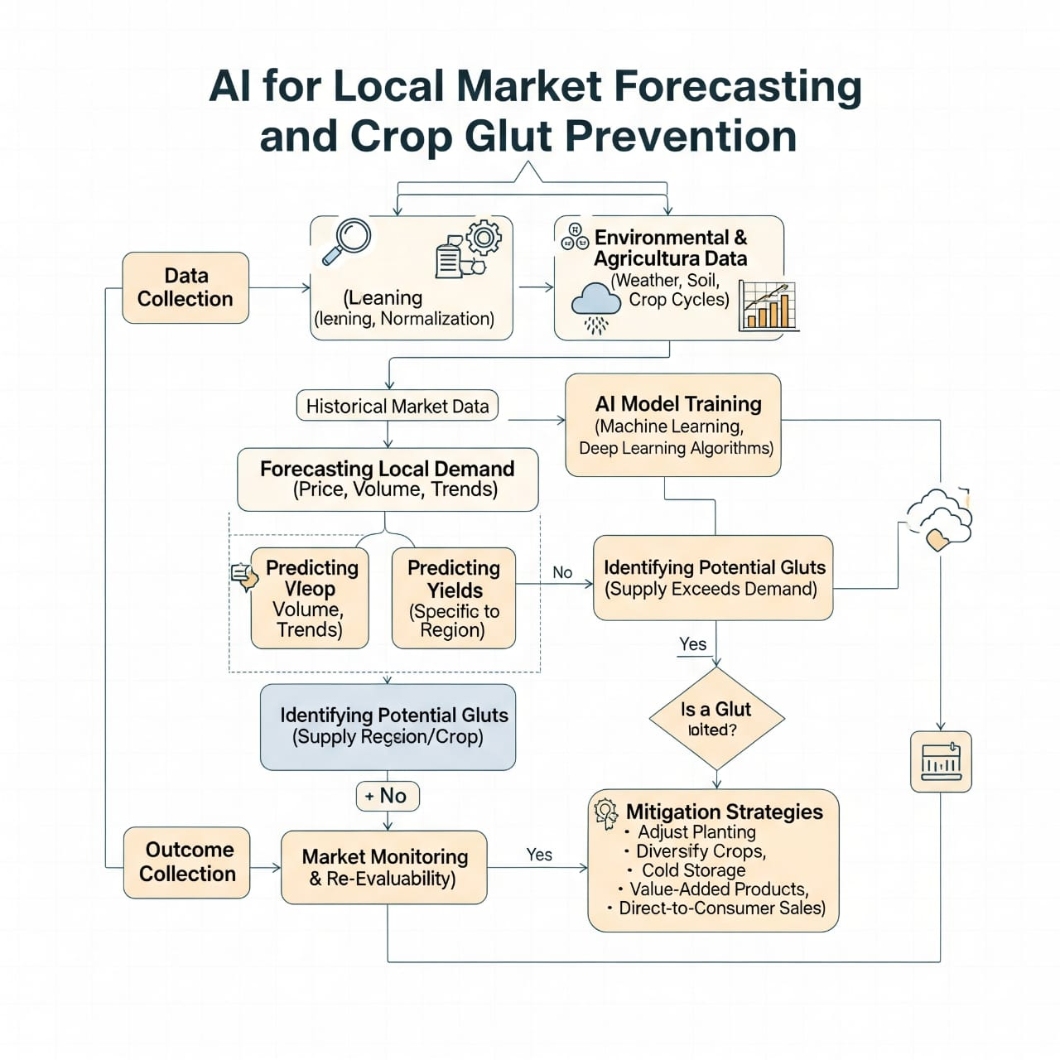
Flow Diagram

Slide 6
Scalabality
Adaptable to Multiple Regions – The AI system can handle data from different local markets and scale to cover larger areas or multiple states without redesigning the model.
Supports Growing Data Volume – Cloud infrastructure and modular AI pipelines allow the system to process increasing amounts of market and crop data efficiently as the user base expands.

Slide 7
Interface
Market Demand Forecast Dashboard – shows AI-predicted demand and price trends for local crops.
Farmer Advisory & Alerts – gives suggestions on what to grow/sell and warns about possible gluts.
Local Market Insights – compares nearby markets, showing where farmers can get the best price.

Slide 8
Conclusion
AI-driven forecasting helps farmers make smarter decisions, reducing the risk of oversupply and price crashes.
Preventing crop gluts ensures better income for farmers and less food wastage, benefiting the entire supply chain.
THANK YOU

